Slide 1
Connect
(better)
CPSC 344
Team Socially Awkward Penguins

Slide 2
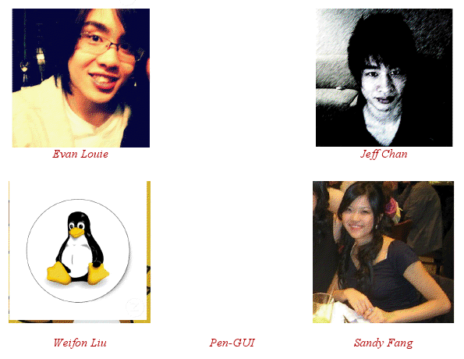
Who We Are

Slide 3
Results of Interviews
Professors:
Too many options to accomplish simple tasks
Exam creation specifically noted.
The lack of the ability to easily 'inherit' course websites makes usage of personal websites preffered
Students:
Cluttered UI
Believed to be not utilized enough by professors to make truly useful.
Project management wanted to as feature by all.

Slide 4
Demo
1. Inheritance
2. Test Creation
3. Grouping

